Slide 1
Valuation Analysis Update for LendingCasas Inc
By: Edward Mendoza

Slide 2
Background:
LendingCasas Inc. is a fin-tech start-up in the mortgage lending space dedicated to building a proprietary algorithmic model that accurately predicts home values based on the attributes of the property within a given location.
Although some aspects of the valuation analysis is highly traditional (reviewing county records, cross-housing analysis), the company is determined to improve upon their model by ”lending” credence to this model in order to streamline the brick-and-mortar calculations that most Valuation Analysts do on a daily basis.

Slide 3
Problem Statement
I will be providing an update about the proprietary model to the newly employed Valuation Analysts of LendingCasas Inc. to look out for the following key attributes of a property and ensure that they are given the information necessary to value the property accordingly.

Slide 4
Some Quick Facts from Realtor as of 2020
Median Listing Home Price - $267K
Median Listing Home Price/Sq Ft: $170
Median Sold Home Price: $248K
*Information Gathered from https://www.realtor.com/realestateandhomes-search/Ames_IA/overview

Slide 5
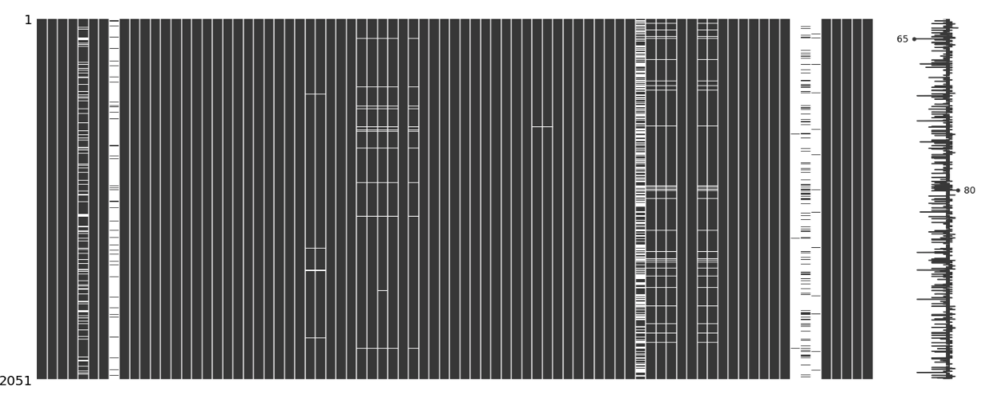
The Data Cleaning Process
Visual Representation of My Null Values
How I scrubbed these values were the following:
Dropped Columns
Imputed the mean for the empty columns
Added a zero where the number of nulls were less than 10

Slide 6
Dummy Variables
Added Dummy Variables to the following features:
Bsmt Qual
Exter Qual
Kitchen Qual
House Style
Garage Finish

Slide 7
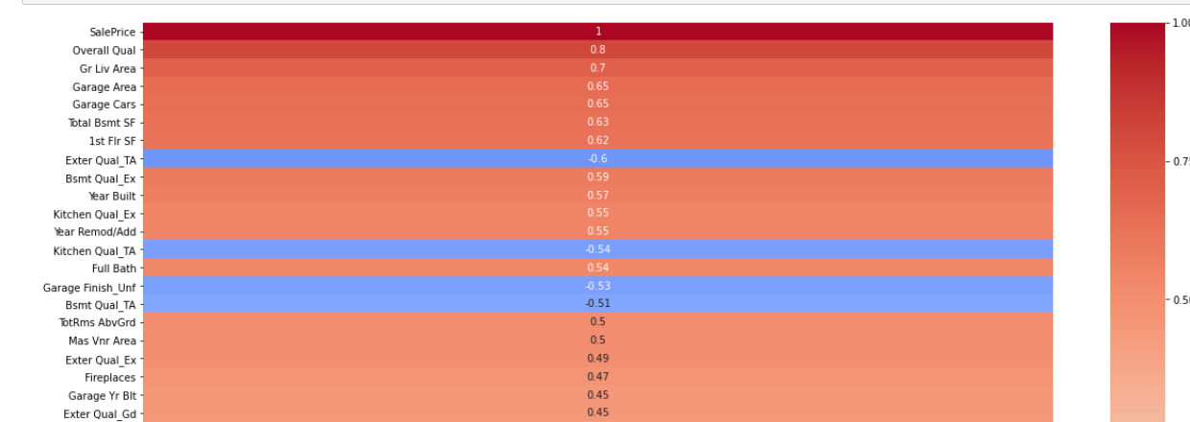
Correlation Heat Map

Slide 8
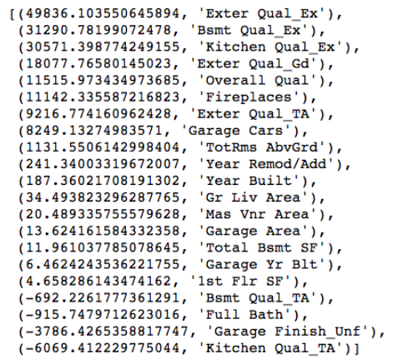
My Coefficients with their values

Slide 9
Recommendations
Based on the features I inputted in the model, it seems that, holding all else constant:
Excellent External Quality
Excellent Basement Quality
Excellent Kitchen Quality
Overall Quality
Large Garages
Fireplaces! (Iowans love to be cozy)
All contribute to an increase in the housing price of a home in Iowa

Slide 10
Thank you for your time

